Slide 1
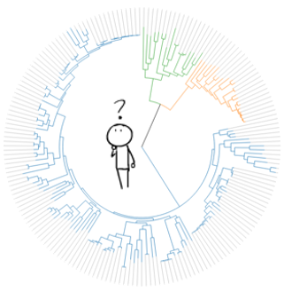





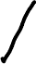




data!
exclude unreliable participants?
yes
no
consolidate across conditions?
consolidate across conditions?
yes
no
yes
no
use gender as a covariate?
use gender as a covariate?
use gender as a covariate?
use gender as a covariate?
…
…
…
…
…
…
…
…

Slide 2



Degrees of freedom to fit evidence to hypothesis
One particular set of analytic decisions
One particular set of interpretive decisions
Degrees of freedom to fit hypothesis to evidence
One combination of evidence and interpretation among many!

Slide 3


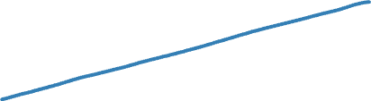
Risk of bias
Confidence
Level
Sensitivity to serendipitous discovery
Minimal or no registration
Exploratory analyses
Data-dependent decision-making
Highly specific preregistration
Confirmatory analyses
Few or no data-dependent decisions
Prespecification

